Slide 1
Business Statistics:
A First Course
(3rd Edition)
Chapter 10
Simple Linear Regression

Slide 2
Chapter Topics
Types of Regression Models
Determining the Simple Linear Regression Equation
Measures of Variation
Assumptions of Regression and Correlation
Residual Analysis
Measuring Autocorrelation
Inferences about the Slope

Slide 3
Chapter Topics
(continued)
Correlation - Measuring the Strength of the Association
Estimation of Mean Values and Prediction of Individual Values
Pitfalls in Regression and Ethical Issues

Slide 4
Purpose of Regression Analysis
Regression Analysis is Used Primarily to Model Causality and Provide Prediction
  Predict the values of a dependent (response) variable based on values of at least one independent (explanatory) variable
  Explain the effect of the independent variables on the dependent variable

Slide 5
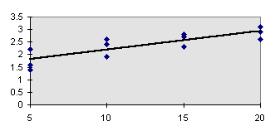
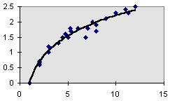
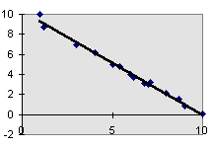
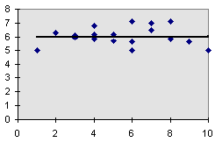
Types of Regression Models
Positive Linear Relationship
Relationship NOT Linear
Negative Linear Relationship
No Relationship

Slide 6
Simple Linear Regression Model
Relationship Between Variables is Described by a Linear Function
The Change of One Variable Causes the Other Variable to Change
A Dependency of One Variable on the Other

Slide 7
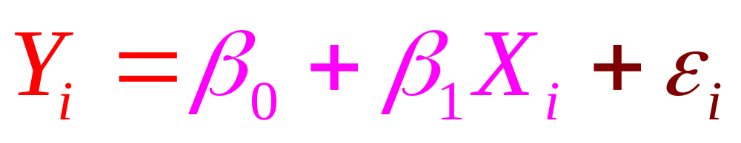
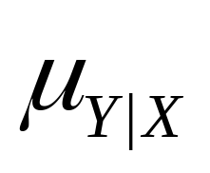
Simple Linear Regression Model
(continued)
Population regression line is a straight line that describes the dependence of the average value (conditional mean) of one variable on the other
Population Slope
Coefficient
Random Error
Population
Y intercept
Dependent (Response) Variable
Population
Regression
Line
(conditional mean)
Independent (Explanatory) Variable

Slide 8



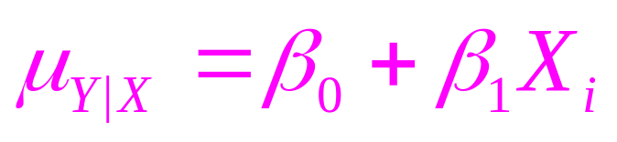

Simple Linear Regression Model
(continued)
Y
(Observed Value of Y) =
= Random Error
(Conditional Mean)
X
Observed Value of Y

Slide 9
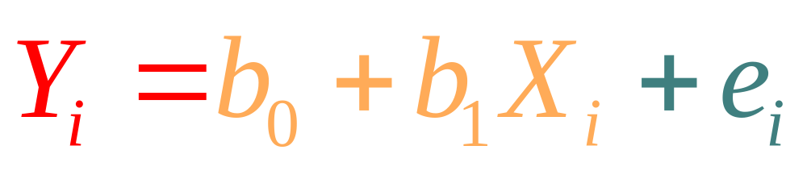
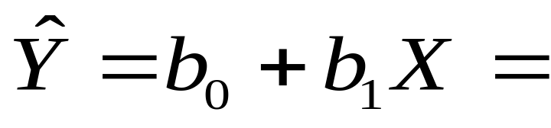
Linear Regression Equation
Sample regression line provides an estimate of the population regression line as well as a predicted value of Y
Sample
Slope
Coefficient
Sample
Y Intercept
Residual
Simple Regression Equation
(Fitted Regression Line, Predicted Value)

Slide 10
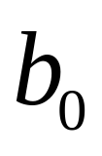
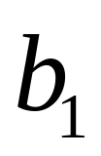
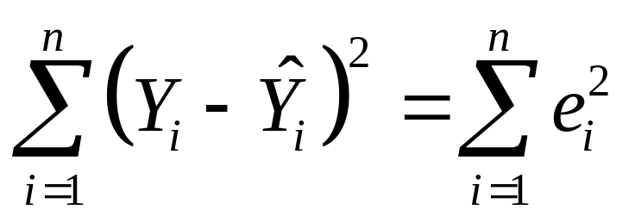
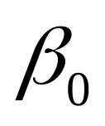
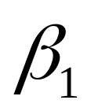
Linear Regression Equation
(continued)
and are obtained by finding the values of and that minimizes the sum of the squared residuals
provides an estimate of
provides and estimate of

Slide 11




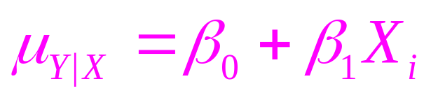
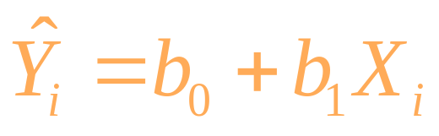

Linear Regression Equation
(continued)
Y
X
Observed Value

Slide 12
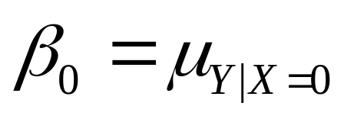
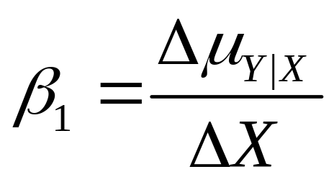
Interpretation of the Slope and Intercept
is the average value of Y when the value of X is zero.
measures the change in the average value of Y as a result of a one-unit change in X.

Slide 13
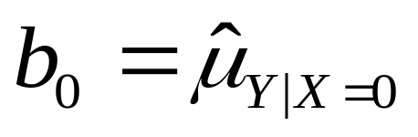
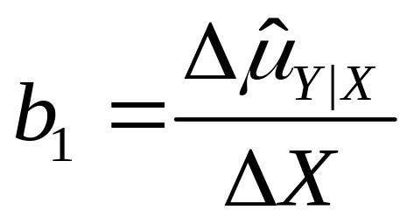
Interpretation of the Slope and Intercept
(continued)
is the estimated average value of Y when the value of X is zero.
is the estimated change in the average value of Y as a result of a one-unit change in X.

Slide 14
Simple Linear Regression: Example
You wish to examine the linear dependency of the annual sales of produce stores on their sizes in square footage. Sample data for 7 stores were obtained. Find the equation of the straight line that fits the data best.
Annual Store Square Sales Feet ($1000)
1 1,726 3,681
2 1,542 3,395
3 2,816 6,653
4 5,555 9,543
5 1,292 3,318
6 2,208 5,563
7 1,313 3,760

Slide 15
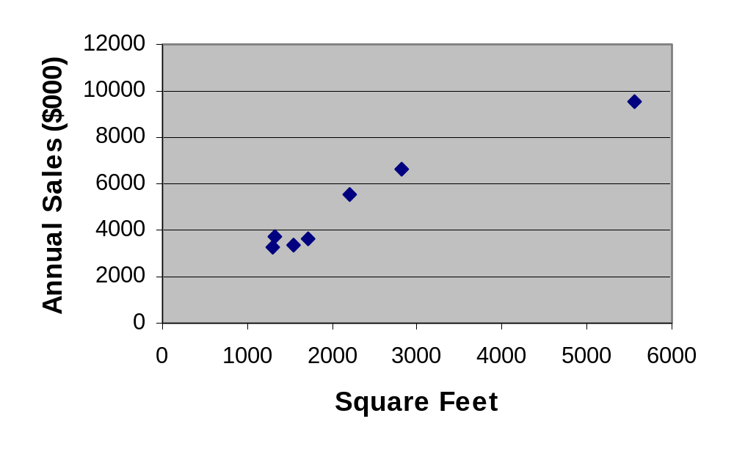
Scatter Diagram: Example
Excel Output

Slide 16
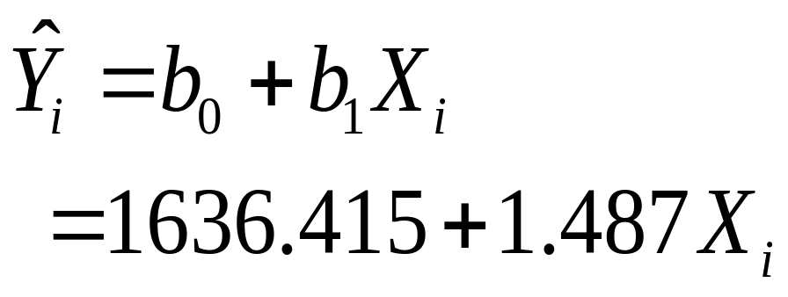
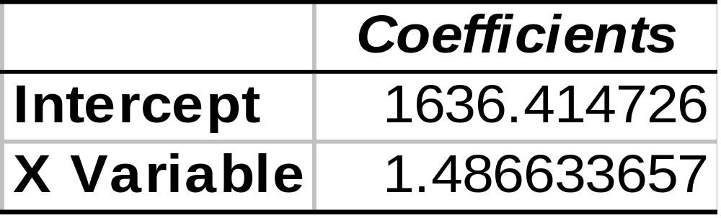
Simple Linear Regression Equation: Example
From Excel Printout:

Slide 17
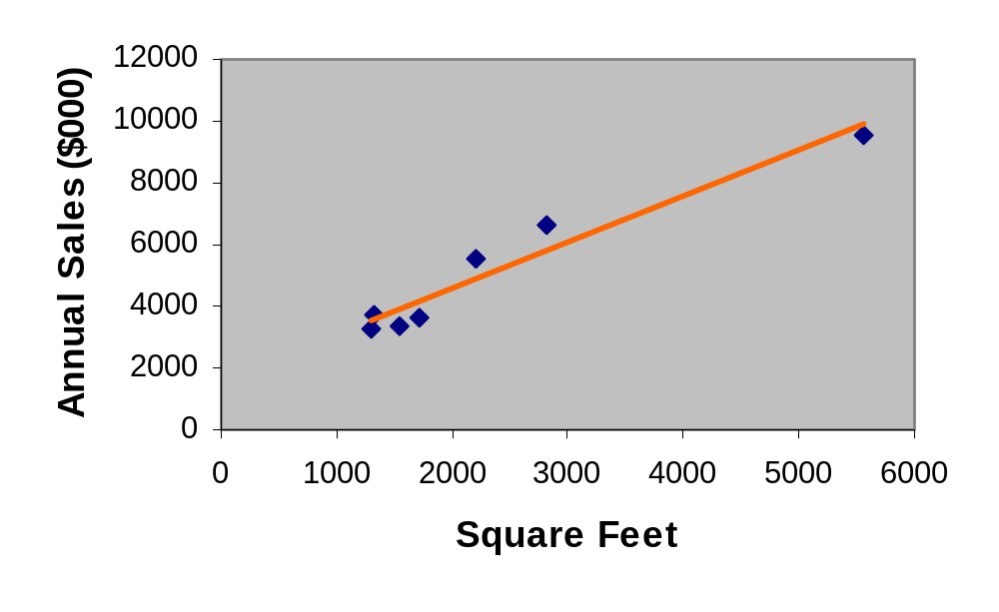
Graph of the Simple Linear Regression Equation: Example
Y_{i} = 1636.415 +1.487X_{i}
∧

Slide 18
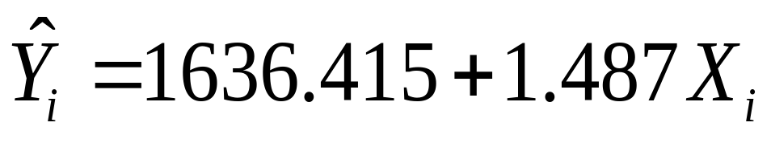
Interpretation of Results: Example
The slope of 1.487 means that each increase of one unit in X, we predict the average of Y to increase by an estimated 1.487 units.
The equation estimates that for each increase of 1 square foot in the size of the store, the expected annual sales are predicted to increase by $1487.

Slide 19

Simple Linear Regression in PHStat
In Excel, use PHStat | Regression | Simple Linear Regression …
EXCEL Spreadsheet of Regression Sales on Footage

Slide 20
Measures of Variation:
The Sum of Squares
SST = SSR + SSE
Total Sample Variability
=
Explained Variability
+
Unexplained Variability

Slide 21

Measures of Variation:
The Sum of Squares
(continued)
SST = Total Sum of Squares
  Measures the variation of the Y_{i} values around their mean,
SSR = Regression Sum of Squares
  Explained variation attributable to the relationship between X and Y
SSE = Error Sum of Squares
  Variation attributable to factors other than the relationship between X and Y

Slide 22
Measures of Variation:
The Sum of Squares
(continued)
Y
∧
SSE =∑(Y_{i} - Y_{i} )²
_
SST = ∑(Y_{i} - Y)²
_
∧
SSR = ∑(Y_{i} - Y)²
_
Y
X
X_{i}

Slide 23
The ANOVA Table in Excel
ANOVA
 | df | SS | MS | F | Significance F
Regression | k | SSR | MSR =SSR/k | MSR/MSE | P-value of the F Test
Residuals | n-k-1 | SSE | MSE =SSE/(n-k-1)
Total | n-1 | SST

Slide 24
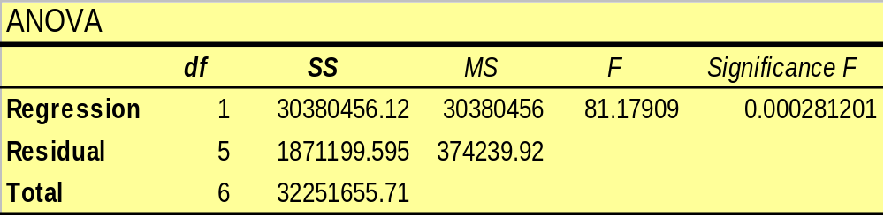
Measures of Variation
The Sum of Squares: Example
Excel Output for Produce Stores
Degrees of freedom
Regression (explained) df
SST
SSE
Error (residual) df
Total df
SSR

Slide 25
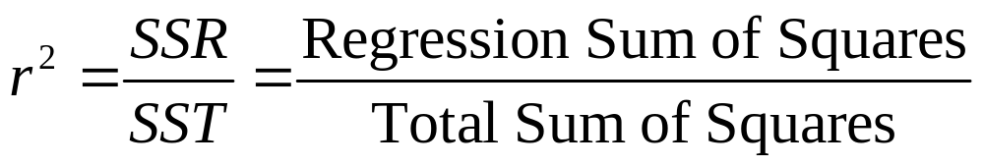
The Coefficient of Determination
Measures the proportion of variation in Y that is explained by the independent variable X in the regression model

Slide 26
Coefficients of Determination (r ²) and Correlation (r)
r² = 1,
Y
r = +1
r² = 1,
r = -1
Y
^
Y
=
b
+
b
X
i
0
1
i
^
Y
=
b
+
b
X
i
0
1
i
X
X
r² = .81,
r = +0.9
r² = 0,
Y
Y
r = 0
^
^
Y
=
b
+
b
X
Y
=
b
+
b
X
i
0
1
i
i
0
1
i
X
X

Slide 27
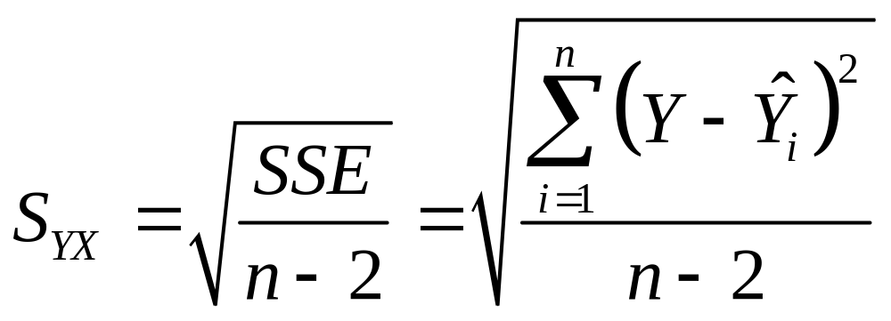
Standard Error of Estimate
The standard deviation of the variation of observations around the regression equation

Slide 28
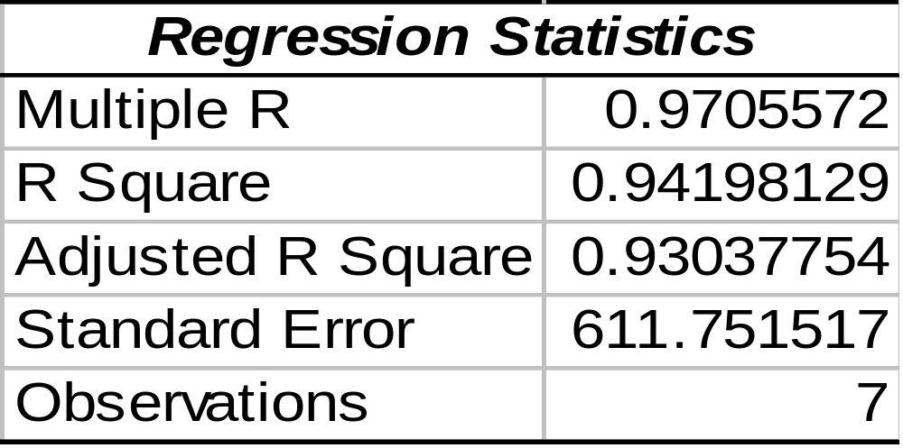
Measures of Variation:
Produce Store Example
Excel Output for Produce Stores
r² = .94
S_{yx}
94% of the variation in annual sales can be explained by the variability in the size of the store as measured by square footage

Slide 29
Linear Regression Assumptions
Normality
  Y values are normally distributed for each X
  Probability distribution of error is normal
2. Homoscedasticity (Constant Variance)
3. Independence of Errors

Slide 30
Variation of Errors Around the Regression Line
Y values are normally distributed around the regression line.
For each X value, the “spread” or variance around the regression line is the same.
f(ε)
Y
X₂
X₁
X
Sample Regression Line

Slide 31
Residual Analysis
Purposes
  Examine linearity
  Evaluate violations of assumptions
Graphical Analysis of Residuals
  Plot residuals vs. X and time

Slide 32

Residual Analysis for Linearity
Y
Y
X
X
e
e
X
X
Not Linear
✓
Linear

Slide 33

Residual Analysis for Homoscedasticity
Y
Y
X
X
SR
SR
X
X
✓
Heteroscedasticity
Homoscedasticity

Slide 34
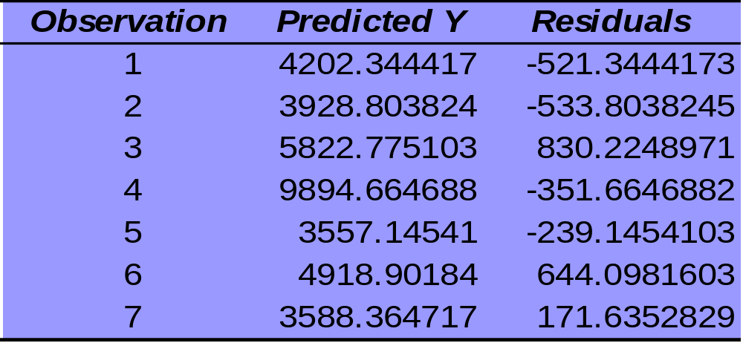
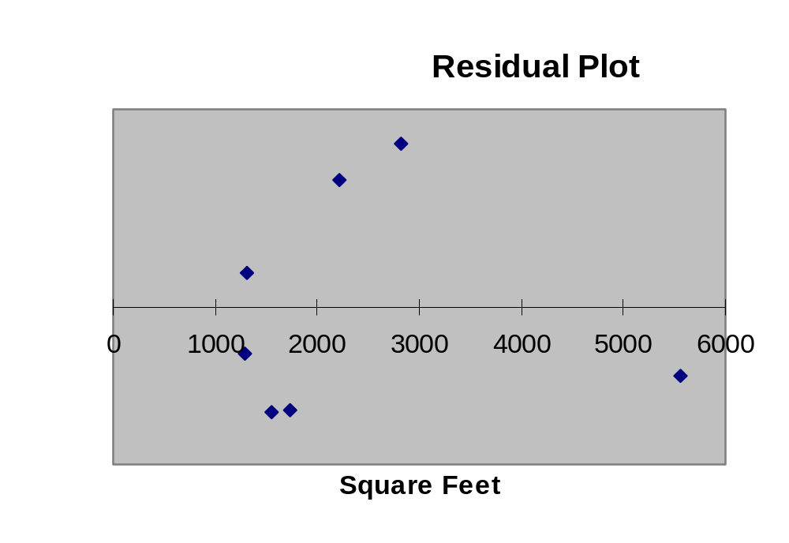
Residual Analysis:Excel Output for Produce Stores Example
Excel Output

Slide 35
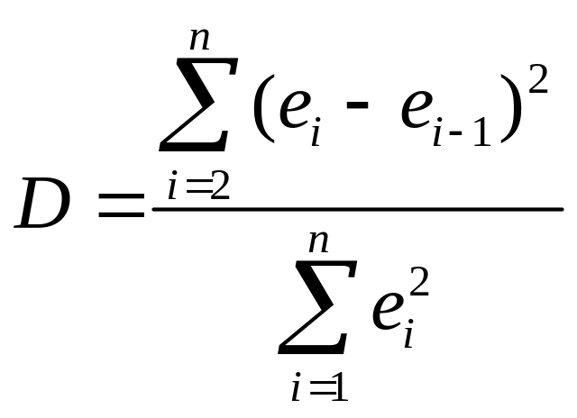
Residual Analysis for Independence
The Durbin-Watson Statistic
  Used when data is collected over time to detect autocorrelation (residuals in one time period are related to residuals in another period)
  Measures violation of independence assumption
Should be close to 2.
If not, examine the model for autocorrelation.

Slide 36
Durbin-Watson Statistic in PHStat
PHStat | Regression | Simple Linear Regression …
  Check the box for Durbin-Watson Statistic

Slide 37
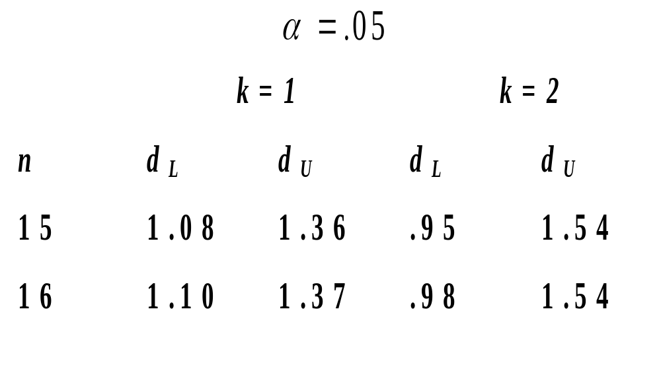
Obtaining the Critical Values of Durbin-Watson Statistic
Table 13.4 Finding critical values of Durbin-Watson Statistic

Slide 38
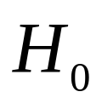
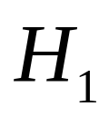
Using the Durbin-Watson Statistic
: No autocorrelation (error terms are independent)
: There is autocorrelation (error terms are not independent)
Reject H₀
(positive
autocorrelation)
Inconclusive
Reject H₀
(negative
autocorrelation)
Accept H₀
(no autocorrelatin)
0
d_{L}
d_{U}
2
4-d_{U}
4-d_{L}
4

Slide 39

Residual Analysis for Independence
Graphical Approach
Not Independent
✓
Independent
e
e
Time
Time
Cyclical Pattern
No Particular Pattern
Residual Is Plotted Against Time to Detect Any Autocorrelation

Slide 40
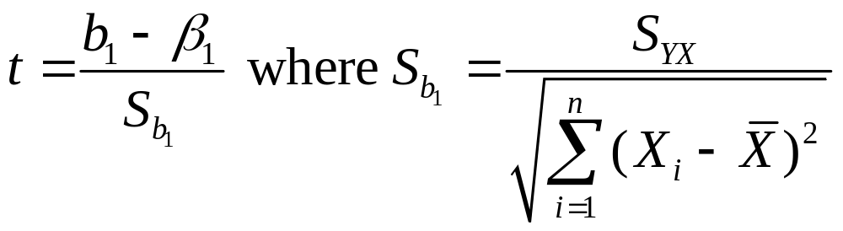
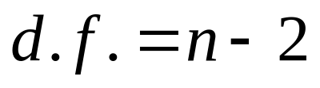
Inference about the Slope: t Test
t Test for a Population Slope
  Is there a linear dependency of Y on X ?
Null and Alternative Hypotheses
  H₀: β₁ = 0 (No Linear Dependency)
  H₁: β₁ ≠ 0 (Linear Dependency)
Test Statistic

Slide 41
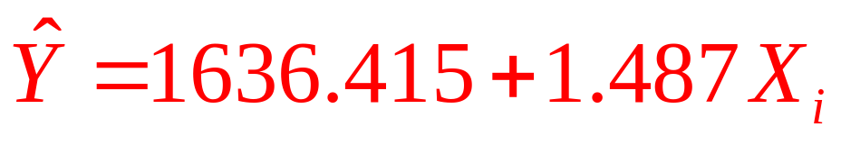
Example: Produce Store
Data for 7 Stores:
Estimated Regression Equation:
Annual Store Square Sales Feet ($000)
1 1,726 3,681
2 1,542 3,395
3 2,816 6,653
4 5,555 9,543
5 1,292 3,318
6 2,208 5,563
7 1,313 3,760
The slope of this model is 1.487.
Does Square Footage Affect Annual Sales?

Slide 42

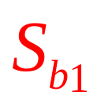

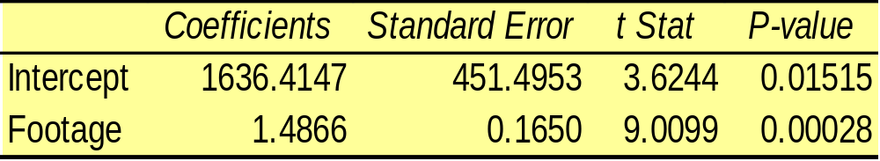
Inferences about the Slope: t Test Example
Test Statistic:
Decision:
Conclusion:
H₀: β₁ = 0
H₁: β₁ ≠ 0
α = .05
df = 7 - 2 = 5
Critical Value(s):
From Excel Printout
Reject
Reject
Reject H₀
.025
.025
There is evidence that square footage affects annual sales.
-2.5706
0
2.5706
t

Slide 43
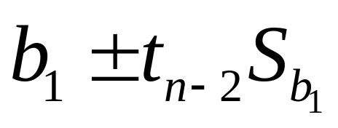
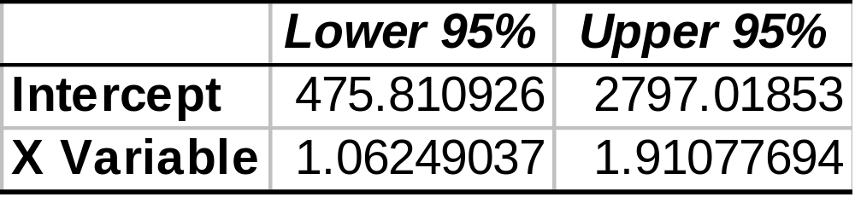
Inferences about the Slope: Confidence Interval Example
Confidence Interval Estimate of the Slope:
Excel Printout for Produce Stores
At 95% level of confidence the confidence interval for the slope is (1.062, 1.911). Does not include 0.
Conclusion: There is a significant linear dependency of annual sales on the size of the store.

Slide 44
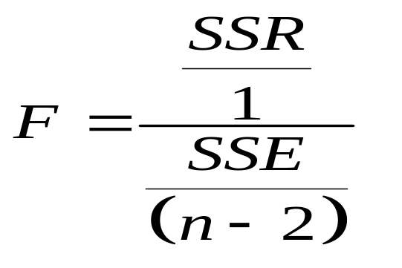
Inferences about the Slope:
F Test
F Test for a Population Slope
  Is there a linear dependency of Y on X ?
Null and Alternative Hypotheses
  H₀: β₁ = 0 (No Linear Dependency)
  H₁: β₁ ≠ 0 (Linear Dependency)
Test Statistic
  Numerator d.f.=1, denominator d.f.=n-2

Slide 45
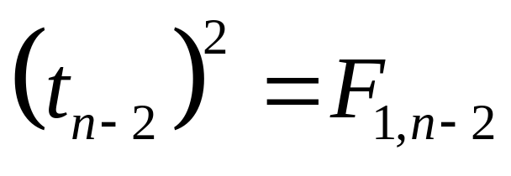
Relationship between a t Test and an F Test
Null and Alternative Hypotheses
  H₀: β₁ = 0 (No Linear Dependency)
  H₁: β₁ ≠ 0 (Linear Dependency)

Slide 46
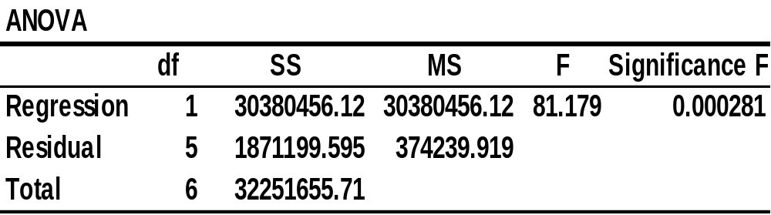
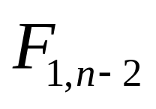
Inferences about the Slope:
F Test Example
Test Statistic:
Decision:
Conclusion:
H₀: β₁ = 0
H₁: β₁ ≠ 0
α = .05
numerator
df = 1
denominator
df = 7 - 2 = 5
From Excel Printout
Reject H₀
Reject
α = .05
There is evidence that square footage affects annual sales.
0
6.61

Slide 47
Purpose of Correlation Analysis
Correlation Analysis is Used to Measure Strength of Association (Linear Relationship) Between 2 Numerical Variables
  Only Strength of the Relationship is Concerned
  No Causal Effect is Implied

Slide 48
Purpose of Correlation Analysis
(continued)
Population Correlation Coefficient ρ (Rho) is Used to Measure the Strength between the Variables
Sample Correlation Coefficient r is an Estimate of ρ and is Used to Measure the Strength of the Linear Relationship in the Sample Observations

Slide 49
Sample of Observations from Various r Values
Y
Y
Y
X
X
X
r = -1
r = -.6
r = 0
Y
Y
X
X
r = .6
r = 1

Slide 50
Features of ρ and r
Unit Free
Range between -1 and 1
The Closer to -1, the Stronger the Negative Linear Relationship
The Closer to 1, the Stronger the Positive Linear Relationship
The Closer to 0, the Weaker the Linear Relationship

Slide 51
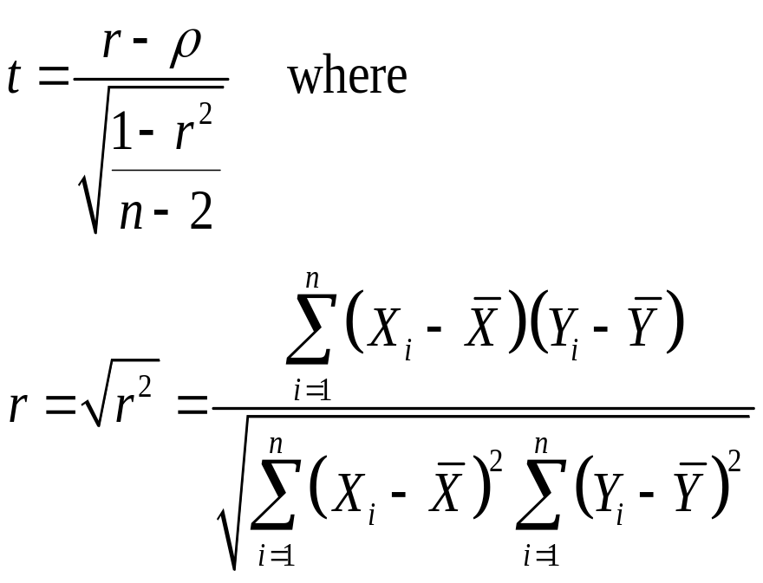
t Test for Correlation
Hypotheses
  H₀: ρ = 0 (No Correlation)
  H₁: ρ ≠ 0 (Correlation)
Test Statistic

Slide 52
Example: Produce Stores
From Excel Printout
r
Is there any evidence of linear relationship between Annual Sales of a store and its Square Footage at .05 level of significance?
H₀: ρ = 0 (No association)
H₁: ρ ≠ 0 (Association)
α = .05
df = 7 - 2 = 5

Slide 53
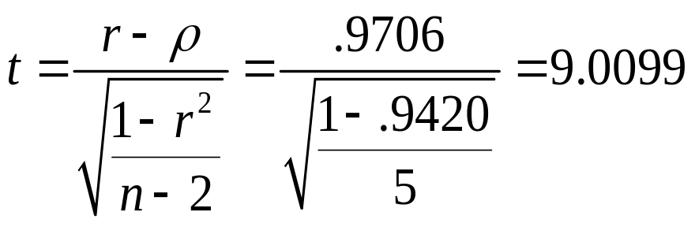
Example: Produce Stores Solution
Decision:
Reject H₀
Conclusion:
There is evidence of a linear relationship at 5% level of significance
Critical Value(s):
Reject
Reject
The value of the t statistic is exactly the same as the t statistic value for test on the slope coefficient
.025
.025
-2.5706
0
2.5706

Slide 54
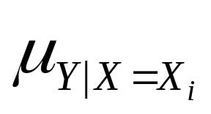
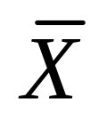

Estimation of Mean Values
Confidence Interval Estimate for :
The Mean of Y given a particular X_{i}
Size of interval vary according to distance away from mean,
Standard error of the estimate
t value from table with df=n-2

Slide 55

Prediction of Individual Values
Prediction Interval for Individual Response Y_{i} at a Particular X_{i}
Addition of 1 increases width of interval from that for the mean of Y

Slide 56
Interval Estimates for Different Values of X
Prediction Interval for a individual Y_{i}
Confidence Interval for the mean of Y
Y
∧
Y_{i} = b₀ + b₁X_{i}
X
A given X

Slide 57
Example: Produce Stores
Data for 7 Stores:
Annual Store Square Sales Feet ($000)
1 1,726 3,681
2 1,542 3,395
3 2,816 6,653
4 5,555 9,543
5 1,292 3,318
6 2,208 5,563
7 1,313 3,760
Consider a store with 2000 square feet.
Regression Equation Obtained:

Slide 58


Estimation of Mean Values: Example
Confidence Interval Estimate for
Find the 95% confidence interval for the average annual sales for stores of 2,000 square feet
Predicted Sales

Slide 59


Prediction Interval for Y : Example
Prediction Interval for Individual
Find the 95% prediction interval for annual sales of one particular store of 2,000 square feet
Predicted Sales)

Slide 60

Estimation of Mean Values and Prediction of Individual Values in PHStat
In Excel, use PHStat | Regression | Simple Linear Regression …
  Check the “Confidence and Prediction Interval for X=” box
EXCEL Spreadsheet of Regression Sales on Footage

Slide 61
Pitfalls of Regression Analysis
Lacking an Awareness of the Assumptions Underlining Least-squares Regression
Not Knowing How to Evaluate the Assumptions
Not Knowing What the Alternatives to Least-squares Regression are if a Particular Assumption is Violated
Using a Regression Model Without Knowledge of the Subject Matter

Slide 62
Strategy for Avoiding the Pitfalls of Regression
Start with a scatter plot of X on Y to observe possible relationship
Perform residual analysis to check the assumptions
Use a histogram, stem-and-leaf display, box-and-whisker plot, or normal probability plot of the residuals to uncover possible non-normality

Slide 63
Strategy for Avoiding the Pitfalls of Regression
(continued)
If there is violation of any assumption, use alternative methods (e.g., least absolute deviation regression or least median of squares regression) to least-squares regression or alternative least-squares models (e.g., curvilinear or multiple regression)
If there is no evidence of assumption violation, then test for the significance of the regression coefficients and construct confidence intervals and prediction intervals

Slide 64
Chapter Summary
Introduced Types of Regression Models
Discussed Determining the Simple Linear Regression Equation
Described Measures of Variation
Addressed Assumptions of Regression and Correlation
Discussed Residual Analysis
Addressed Measuring Autocorrelation

Slide 65
Chapter Summary
(continued)
Described Inference about the Slope
Discussed Correlation - Measuring the Strength of the Association
Addressed Estimation of Mean Values and Prediction of Individual Values
Discussed Pitfalls in Regression and Ethical Issues

